Slide 1

POSTMAN in Jenkins

Slide 2
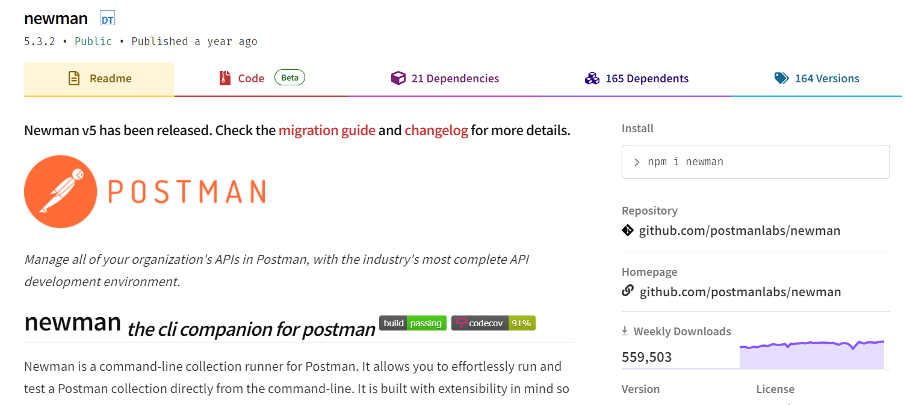
Newman Postman

Slide 3
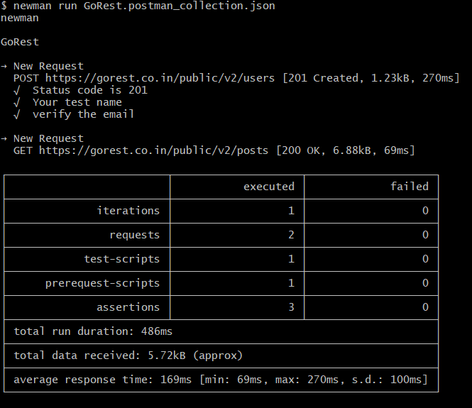
CLI Testing in Postman

Slide 4
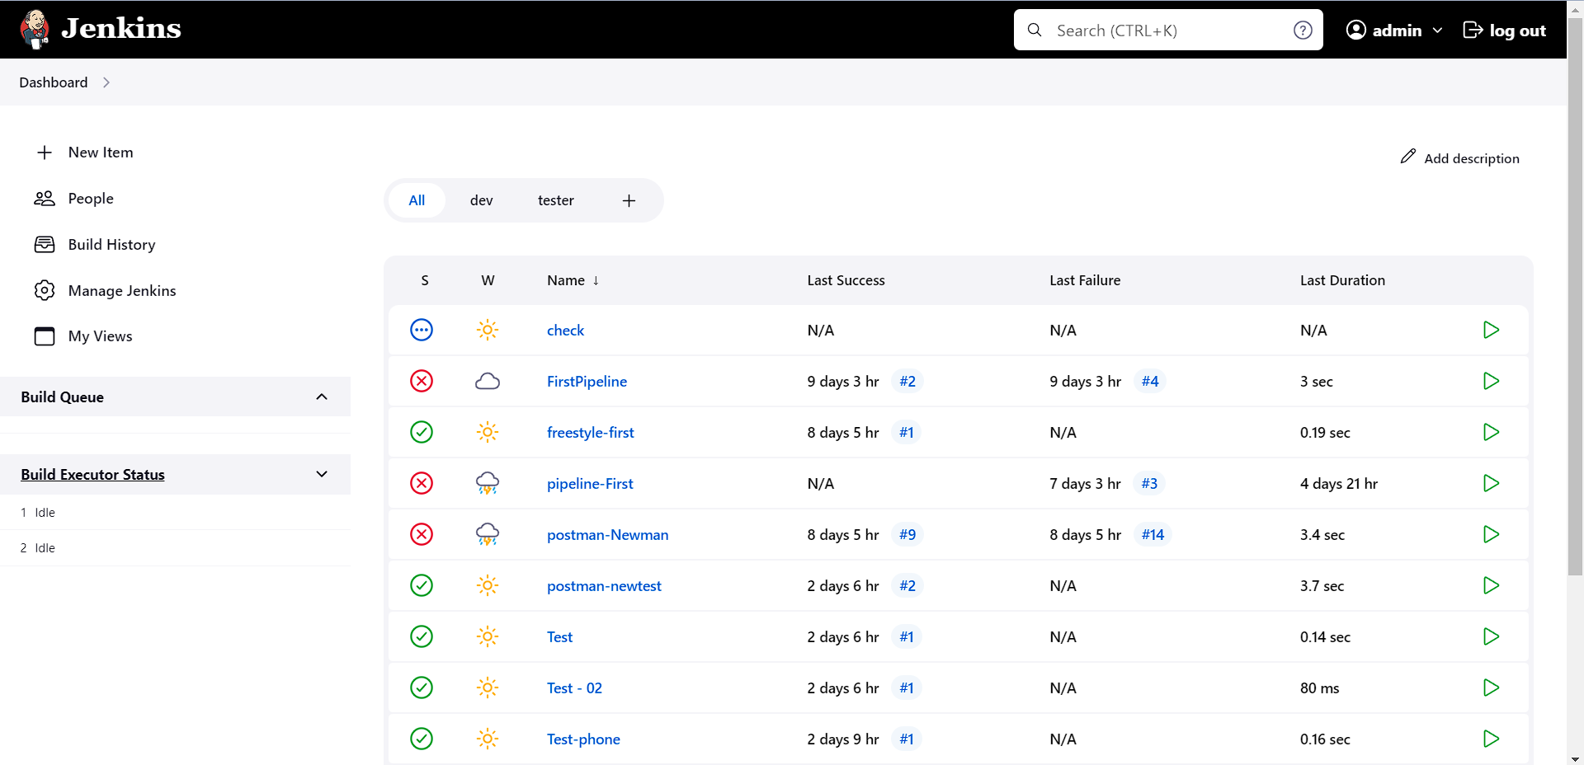
Postman Testing in Jenkins

Slide 5
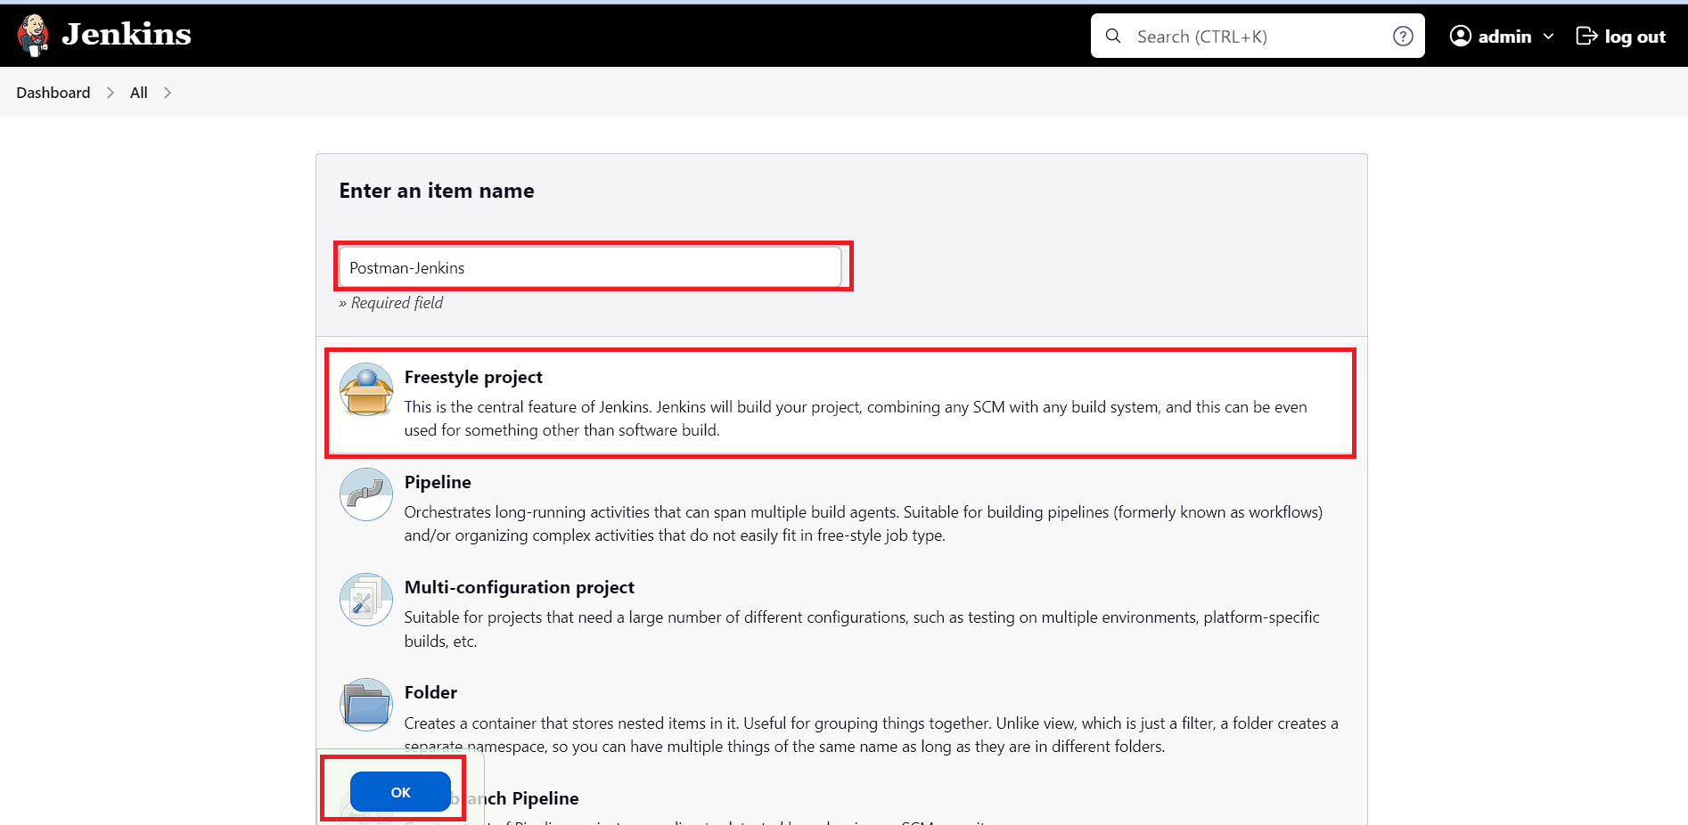
Postman Testing in Jenkins

Slide 6
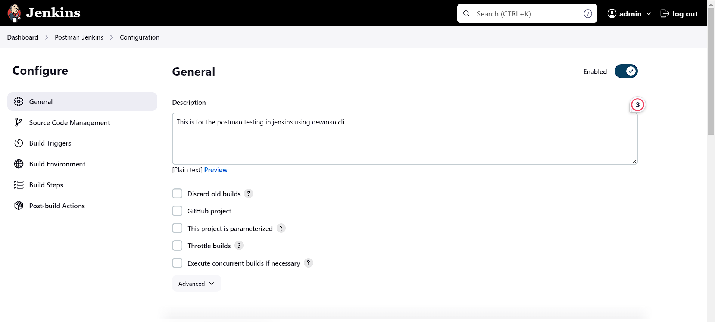
Postman Testing in Jenkins

Slide 7
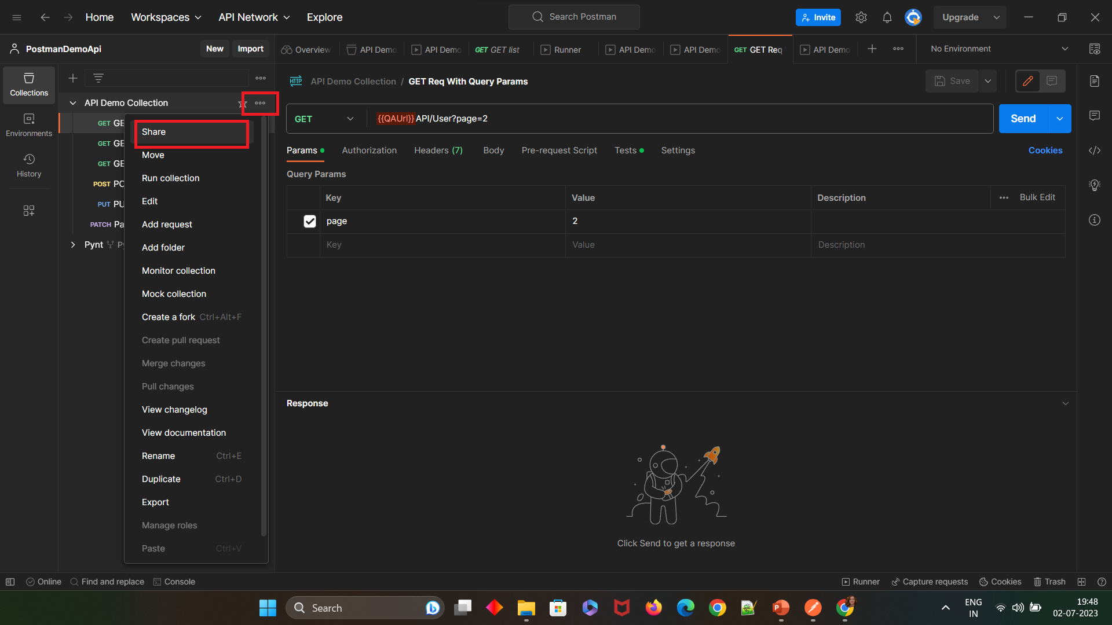
Postman Testing in Jenkins

Slide 8
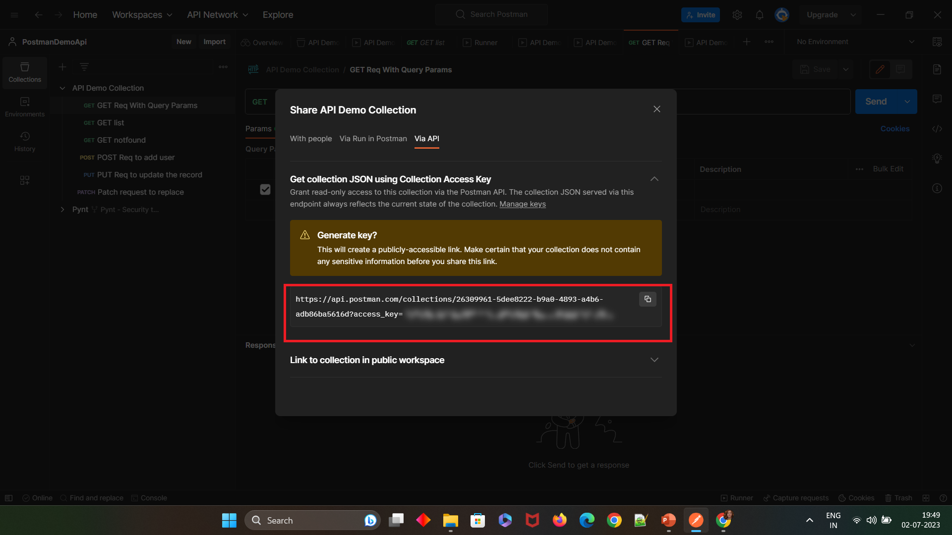
Postman Testing in Jenkins

Slide 9
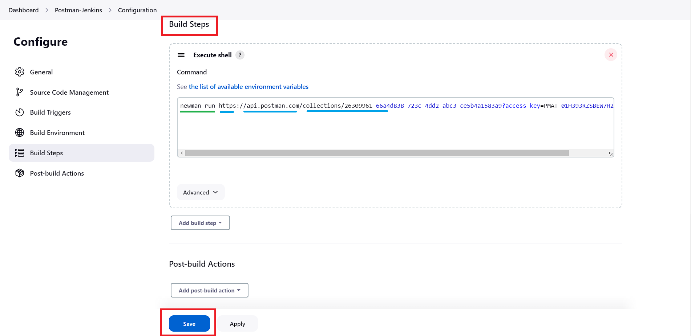
Postman Testing in Jenkins

Slide 10
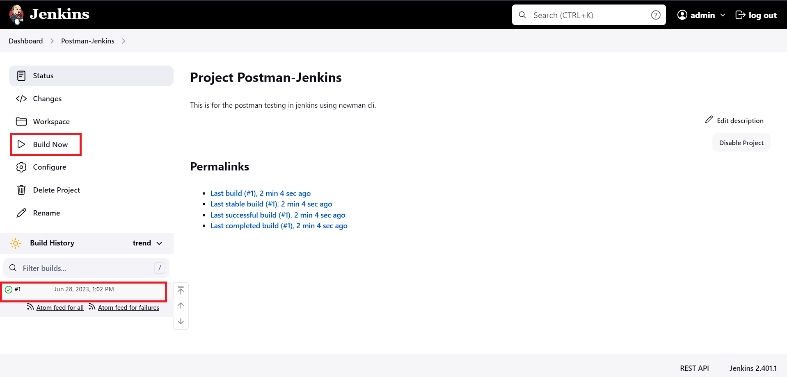
Postman Testing in Jenkins

Slide 11
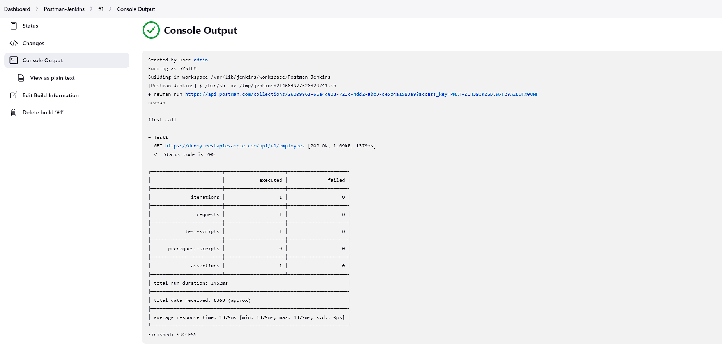
Postman Testing in Jenkins

